Slide 1
Sound Source Verification
SSV
Guillermo Jiménez
Rebecca Snyder
Brian Heath

Slide 2
SOUND SOURCE VERIFICATION
Sound Field
Sound source
Environment
Impact of Sound
SSV
Mitigation

Slide 3
SOUND SOURCE VERIFICATION
What does the sound field look like?
How is the sound perceived by the animal?
SSV
How can we minimise the impact?

Slide 4
PRESENTATION OVERVIEW
Sound field of seismic surveys: two mapping methods presented.
Generate high density SPL map around the source.
Estimate mitigation zones using the SPL map either:
Directly or
Indirectly, to validate or refine a previous sound propagation model
Data Collection
Data Processing
SPL Map
Mitigation Zones

Slide 5
PRESENTATION OVERVIEW
Sound field of seismic surveys: two mapping methods presented.
Generate high density SPL map around the source.
Estimate mitigation zones using the SPL map either:
Directly or
Indirectly, to validate or refine a previous sound propagation model
Data Collection
Data Processing
SPL Map
Mitigation Zones

Slide 6
PRESENTATION OVERVIEW
Sound field of seismic surveys: two mapping methods presented.
Generate high density SPL map around the source.
Estimate mitigation zones using the SPL map either:
Directly or
Indirectly, to validate or refine a previous sound propagation model
Data Collection
Data Processing
SPL Map
Mitigation Zones

Slide 7
PRESENTATION OVERVIEW
Sound field of seismic surveys: two mapping methods presented.
Generate high density SPL map around the source.
Estimate mitigation zones using the SPL map either:
Directly or
Indirectly, to validate or refine a previous sound propagation model
Data Collection
Data Processing
SPL Map
Mitigation Zones

Slide 8
PRESENTATION OVERVIEW
Sound field of seismic surveys: two mapping methods presented.
Generate high density SPL map around the source.
Estimate mitigation zones using the SPL map either:
Directly or
Indirectly, to validate or refine a previous sound propagation model
Data Collection
Data Processing
SPL Map
Mitigation Zones

Slide 9
PRESENTATION OVERVIEW
Sound field of seismic surveys: two mapping methods presented.
Generate high density SPL map around the source.
Estimate mitigation zones using the SPL map either:
Directly or
Indirectly, to validate or refine a previous sound propagation model
Data Collection
Data Processing
SPL Map
Propagation Model
SPL Map
Mitigation Zones

Slide 10
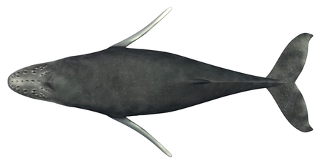
SOUND SOURCE VERIFICATION
190 dB Mitigation Zone
The exclusion area is circular for mitigation purposes.
The actual area delimited by the threshold level might not be circular.
Exclusion Area or Mitigation Zone

Slide 11
SOUND SOURCE VERIFICATION
190 dB Mitigation Zone
The exclusion area is circular for mitigation purposes.
The actual area delimited by the threshold level might not be circular.

Slide 12
SOUND SOURCE VERIFICATION
190 dB Mitigation Zone

Slide 13
SOUND SOURCE VERIFICATION
190 dB Mitigation Zone
180 dB Mitigation Zone

Slide 14
SOUND SOURCE VERIFICATION
190 dB Mitigation Zone
180 dB Mitigation Zone
160 dB Mitigation Zone
High Threshold Levels
Smaller mitigation zones
Prevent auditory injury
Low Threshold Levels
Larger mitigation zones
Prevent behavioural impact

Slide 15
SOUND SOURCE VERIFICATION
The sea is a complex acoustic environment
The sound field depends on the source, bathymetry, water properties and seabed geology.
The environment characteristics vary in space and time.
A good SSV approach must:
Account for the dynamic nature of the underwater environment.
Define a exclusion area (mitigation zone) for each distinct situation

Slide 16
DATA COLLECTION
SOUND FIELD MAPPING METHODS
Deployment: drift buoys or towed hydrophones
Source: impulsive source towed by seismic vessel
Receiver: electronics + acquisition software + GPS + hydrophones
Data collected
Acoustic signal: PCM 16-bit, 2 channels, 88.2 kS/s to 500 kS/s
Position of receiver: GPS and AIS
Position of source: AIS and P190/SPS
Log report: deployment/retrieval times, source status, etc

Slide 17
DATA COLLECTION
DRIFT BUOY DEPLOYMENT
Drifting Buoys
Source Vessel
Direction of Currents
Impulsive Source

Slide 18
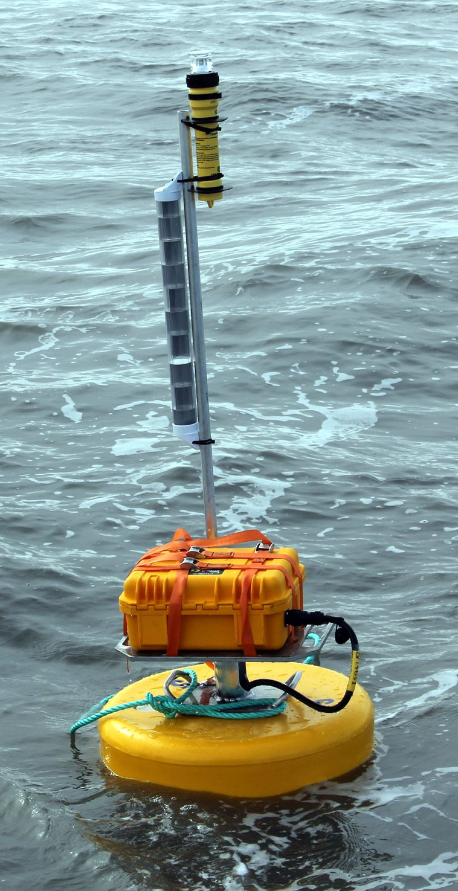
DATA COLLECTION
DRIFT BUOY DESCRIPTION
LED beacon: visual localisation
Radar reflector: RF localisation
Data acquisition unit: electronics, power supply, GPS, satellite tracker
Float
Hydrophones: pole-mounted, distinct gains (pre-selected)

Slide 19
DATA COLLECTION
DRIFTING BUOY DEPLOYMENT ― HIGHLIGHTS
Portable buoys: easy transport, fast and simple assembly
The buoys are light (~40 kg) ― 2 person team only
Typical operations: < 8 h (30 min deployment, 6 h drift, 30 min retrieval)
Data retrieval after each individual deployment
A buoy can cover up to 25 km in fast currents
Recorded shots per deployment: > 12,000 (10 s shot rate, 6 buoys )
Field projects included North Pacific and the Arctic
Less flow noise – Particularly effective in fast currents

Slide 20
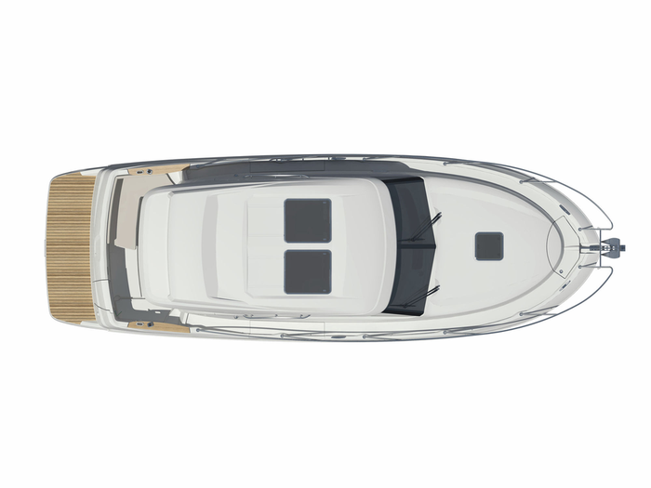
DATA COLLECTION
TOWED HYDROPHONE DEPLOYMENT
Source Vessel
Support Vessel
Impulsive Source
Hydrophone Array
Support vessel: no predefined path
Source vessel: survey lines

Slide 21
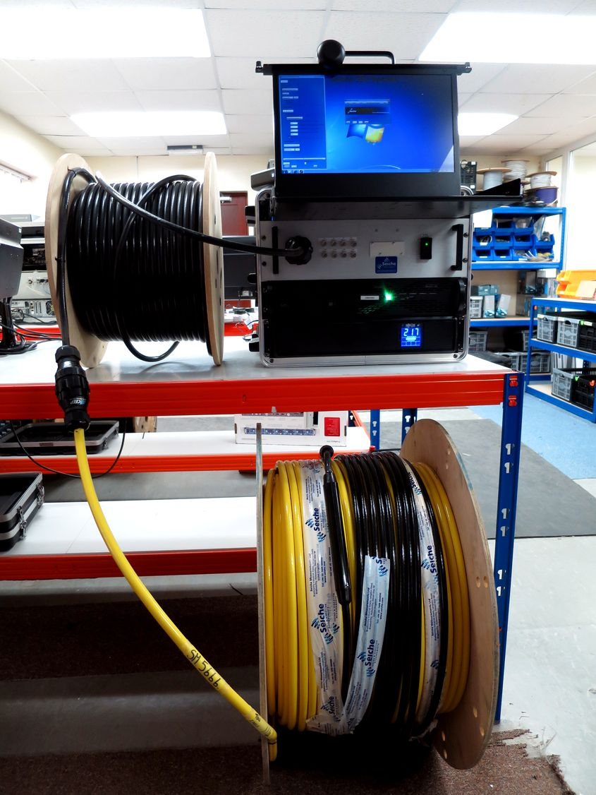
DATA COLLECTION
TOWED HYDROPHONE DESCRIPTION
GPS: placed in a high point on ship
Interface: display + keyboard
Data acquisition box: acoustics + GPS
PC
Deck cable
Hydrophones: various gains
Tow cable (all lengths supplied)

Slide 22
DATA COLLECTION
TOWED HYDROPHONE DEPLOYMENT ― HIGHLIGHTS
Acquisition box and cable: compact system, easy installation
Data acquisition: switch on before survey, switch off after survey
Typical operations: weeks to months
Data retrieved after crew rotation (few weeks)
Covers the entire survey area
Recorded shots per day: > 4,000 (10 s shot rate, 12 h deployment)
Field trials in the North Sea and North Atlantic
Requires no additional resources.

Slide 23
DATA PROCESSING
Acoustic Signal
Vessel
Receiver
Source
Source Position
SPL Map
Source
Receiver Position

Slide 24
DATA PROCESSING
Acoustic Signal
Vessel
Receiver
Source
Source Position
SPL Map
Received SPL
Source
Receiver Position

Slide 25
DATA PROCESSING
Acoustic Signal
Source Position
SPL Map
Receiver Position

Slide 26
DATA PROCESSING
Acoustic Signal
Source Position
SPL Map
Receiver Position

Slide 27
DATA PROCESSING
Acoustic Signal
Source Position
SPL Map
Receiver Position

Slide 28
DATA PROCESSING
Acoustic Signal
Source Position
SPL Map
Receiver Position

Slide 29
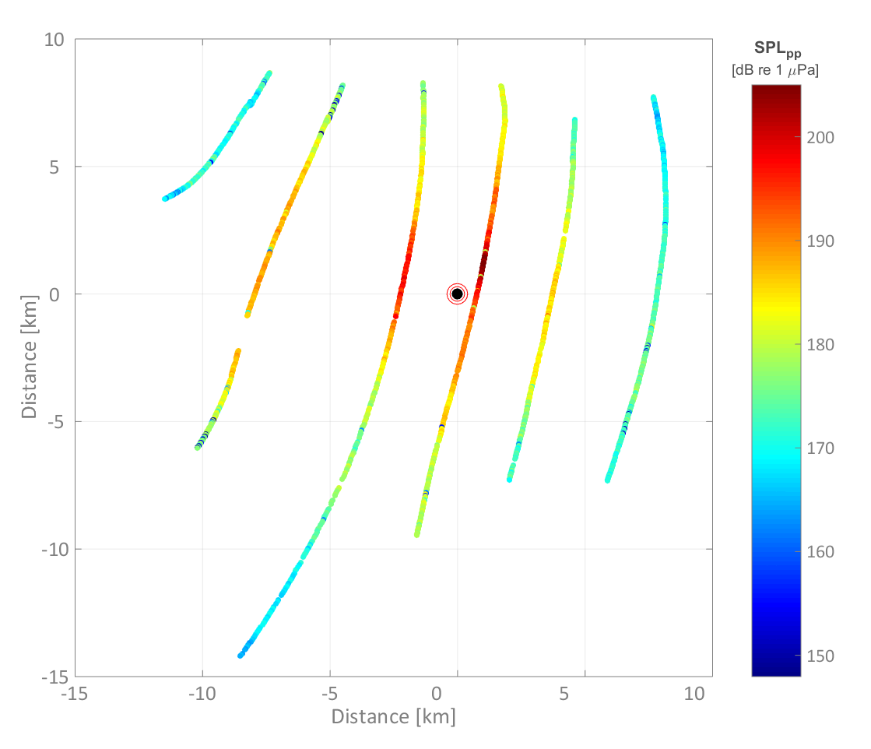
SOUND PRESSURE LEVEL MAPS
SPL MAP FOR DRIFT BUOYS

Slide 30
SOUND PRESSURE LEVEL MAPS
SPL MAP FOR DRIFT BUOYS
1 source position
Multiple receiver positions
Clear image of sound field
Long distance and angle coverage
Easy to interpret
Ideal for model verification
Various source positions may be required

Slide 31
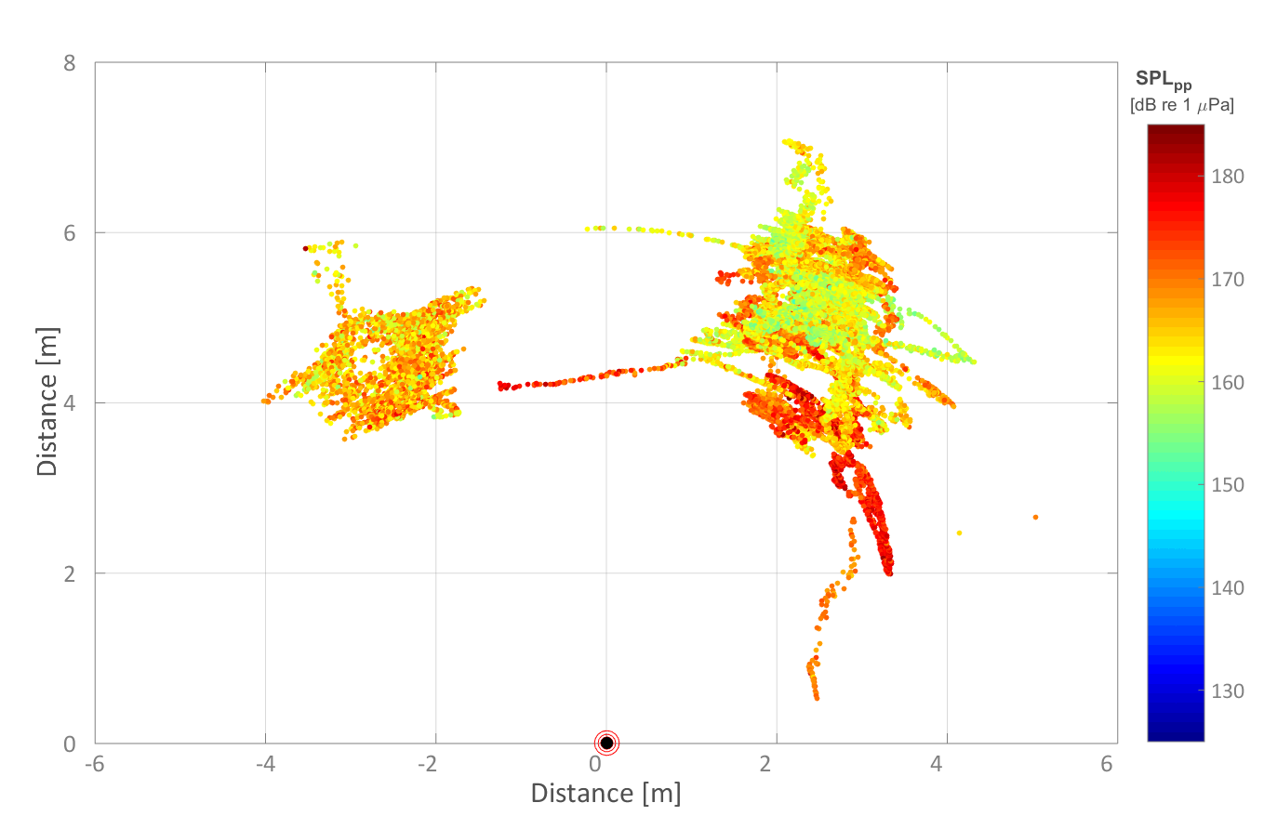
SOUND PRESSURE LEVEL MAPS
SPL MAP FOR A TOWED HYDROPHONE

Slide 32
SOUND PRESSURE LEVEL MAPS
SPL MAP FOR A TOWED HYDROPHONE
Multiple source positions
Multiple receiver positions
Accurate representation of sound field variations
Ideal for model refinement
May be difficult to interpret
Limited distance and angle coverage

Slide 33
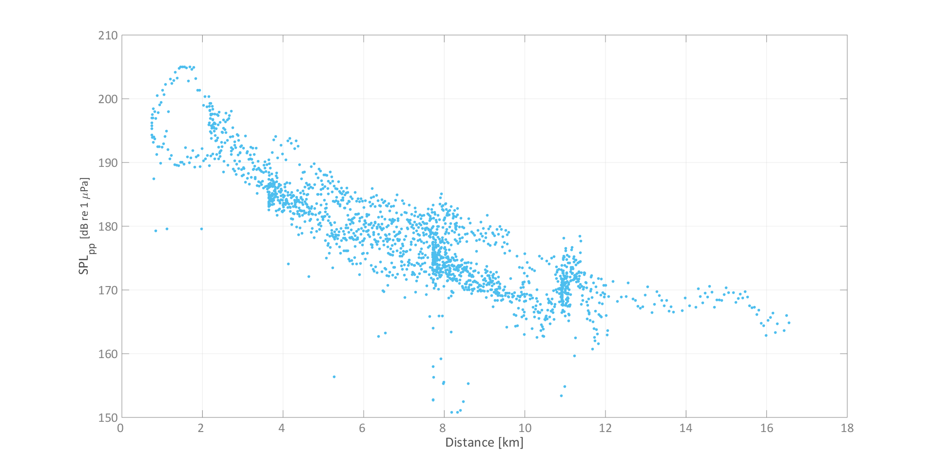
MITIGATION ZONES
DIRECT CALCULATION FROM MEASURED SPL VALUES
SPL_{rms} [dB re 1µPa]
180
170
160
150
140
130
120
Distance [km]

Slide 34
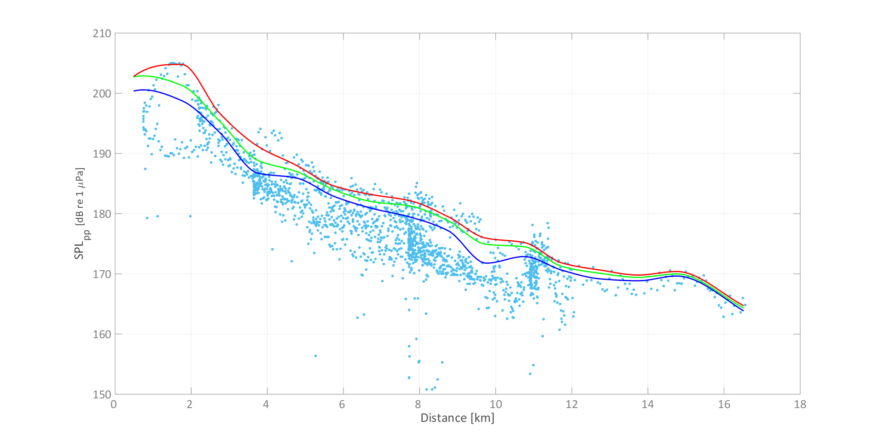
MITIGATION ZONES
DIRECT CALCULATION FROM MEASURED SPL VALUES
SPL_{rms} [dB re 1µPa]
180
170
160
150
140
130
120
Distance [km]

Slide 35
MITIGATION ZONES
DIRECT CALCULATION FROM MEASURED SPL VALUES
SPL_{rms} [dB re 1µPa]
180
170
160
150
140
130
120
95th Percentile Curve
90th Percentile Curve
80th Percentile Curve
4100 m
Distance [km]

Slide 36
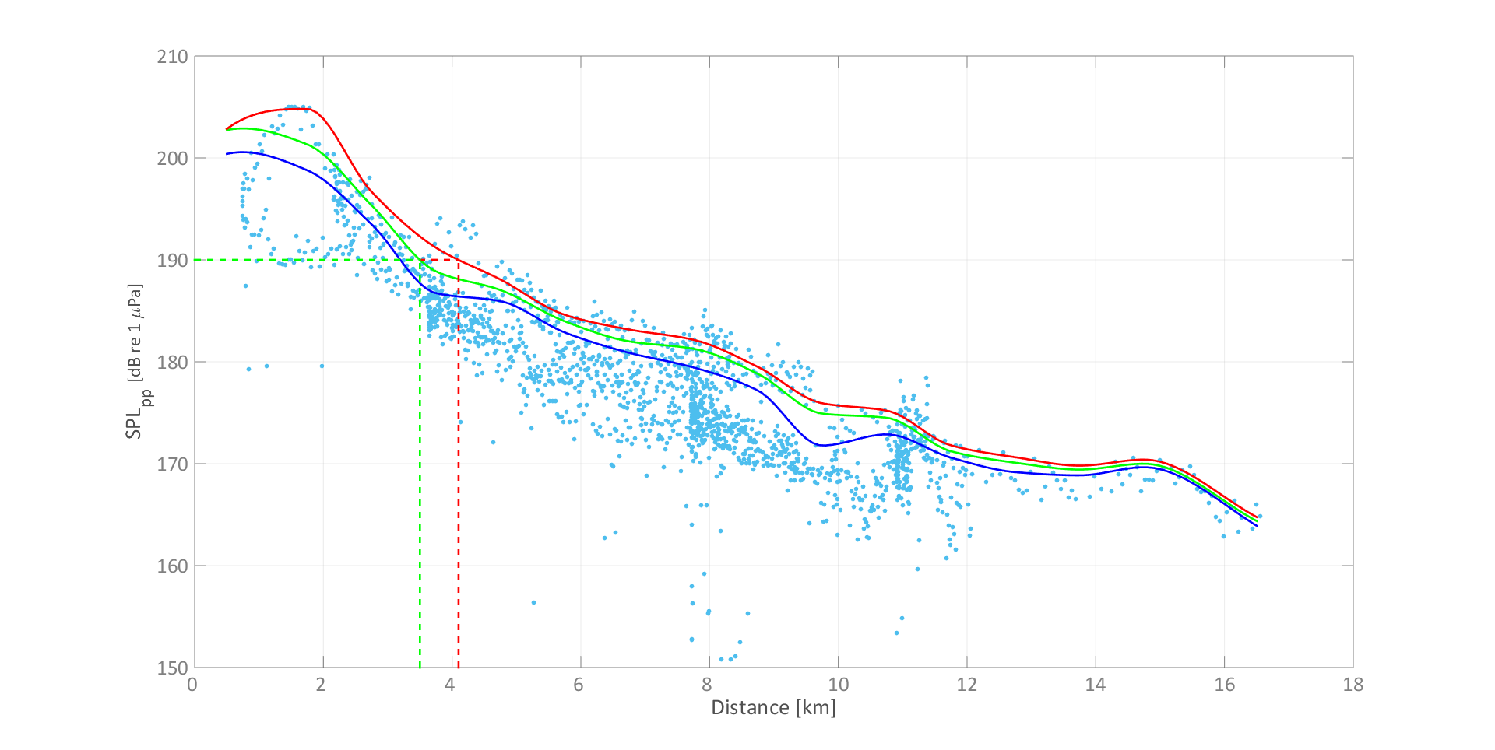
MITIGATION ZONES
DIRECT CALCULATION FROM MEASURED SPL VALUES
SPL_{rms} [dB re 1µPa]
180
170
160
150
140
130
120
95th Percentile Curve
90th Percentile Curve
80th Percentile Curve
3500 m
Distance [km]

Slide 37
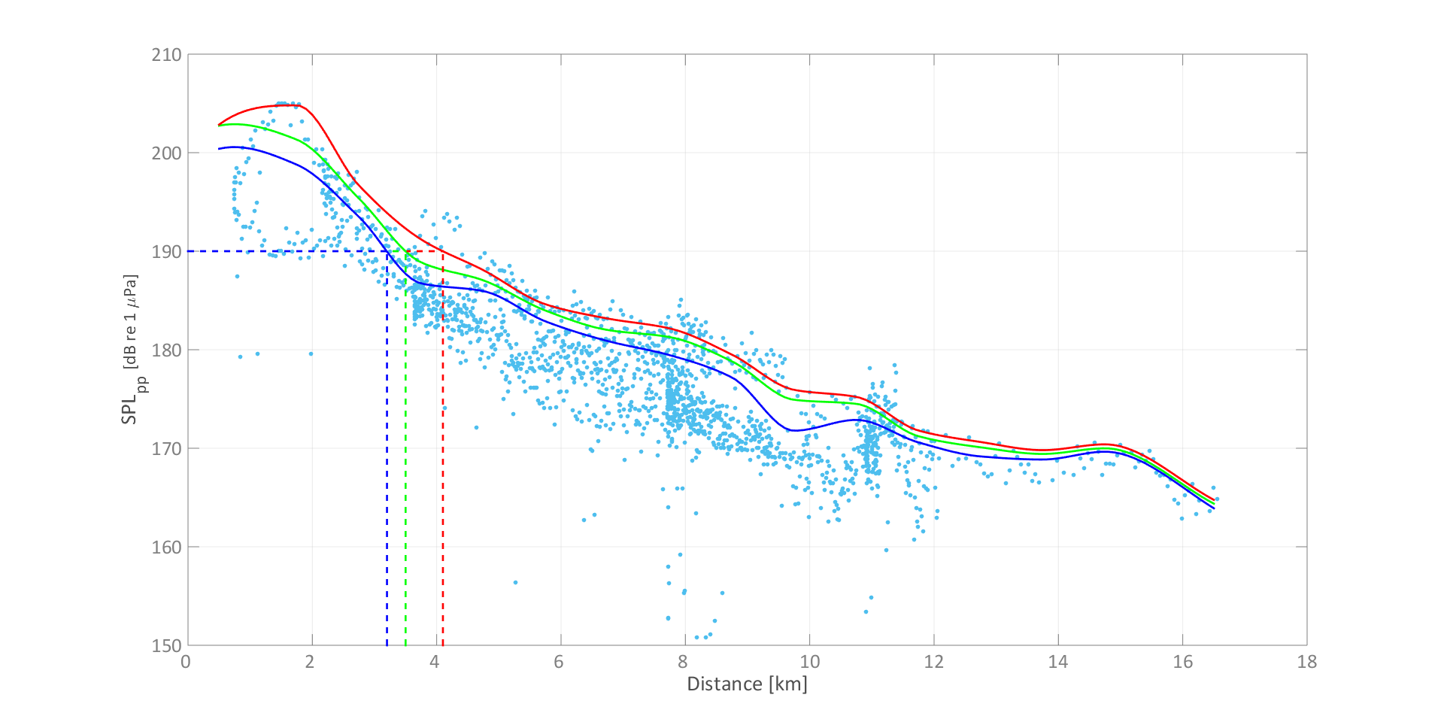
MITIGATION ZONES
DIRECT CALCULATION FROM MEASURED SPL VALUES
SPL_{rms} [dB re 1µPa]
180
170
160
150
140
130
120
95th Percentile Curve
90th Percentile Curve
80th Percentile Curve
3200 m
Distance [km]

Slide 38
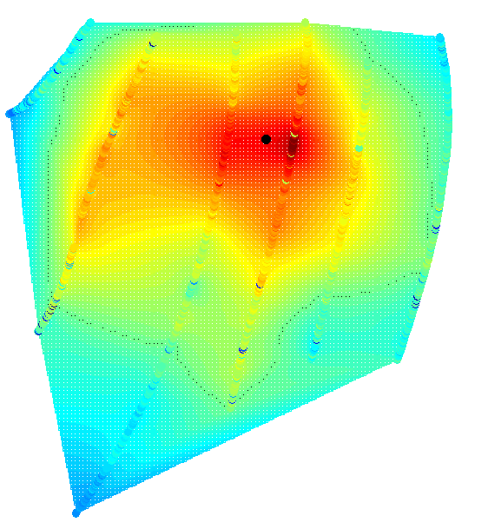
MITIGATION ZONES
DIRECT CALCULATION FROM MEASURED SPL VALUES
Measured SPL map: shows variability of sound field.
Sampling strategy and deployment constraints affect point distributions.
Can be extended with validated propagation model.

Slide 39
SOUND SOURCE VERIFICATION
SUMMARY
Easy deployment, retrieval and implementation
Cost effective
Very large datasets (thousands of SPL points)
Multiple receiver positions
Extensively tested (Pacific, Atlantic, Arctic, North Sea)
Minimal environmental impact
Fast data collection, analysis and reporting (< 24 hours)

